Slide 1
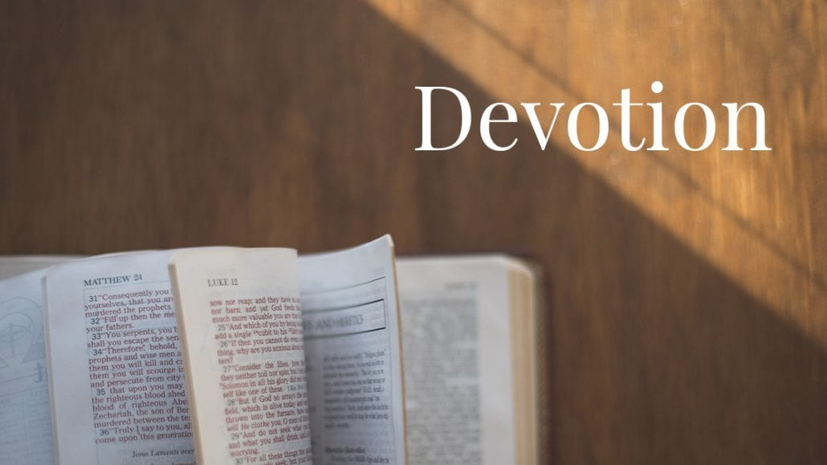
BEING FAITHFUL
KEY TEXT:
NUMBERS 12:4–9

Slide 2
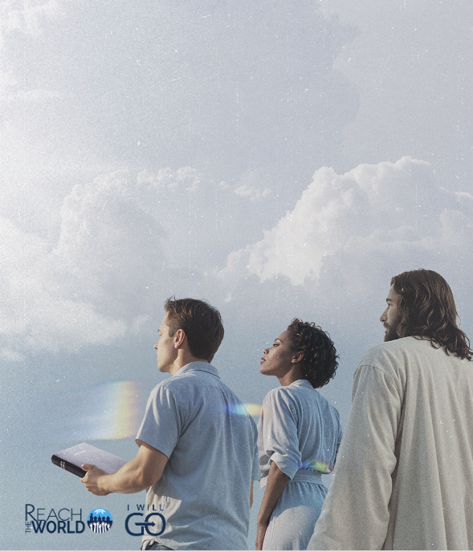
INTRODUCTION
The call to be faithful is not an ordinary task. It is a calling to reflect one of God’s divine attribute.

Slide 3
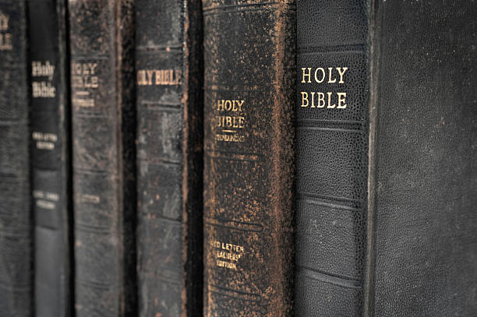
In both the Old and New Testaments, God is described and named as faithful (Deuteronomy 9:7; Isaiah 49:7; 1Corinthians 1:9; 10:13; 2 Corinthians 1:18; 1Thessalonians 5:24; 1John 1:9).

Slide 4
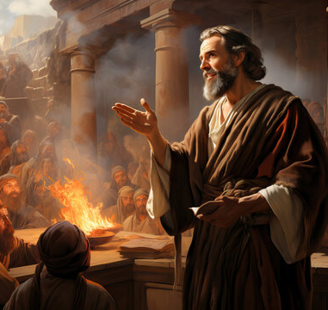
2Timothy 2:13
“If we are faithless, He remains faithful; He cannot deny Himself.”
Because His is faithful and cannot act contrary to His name, He remains faithful even if we are faithless or unfaithful.
Notes:
In 2Timothy 2:13, Paul emphasized that “If we are faithless, He remains faithful; He cannot deny Himself.” Because His is faithful and cannot act contrary to His name, He remains faithful even if we are faithless or unfaithful.

Slide 5
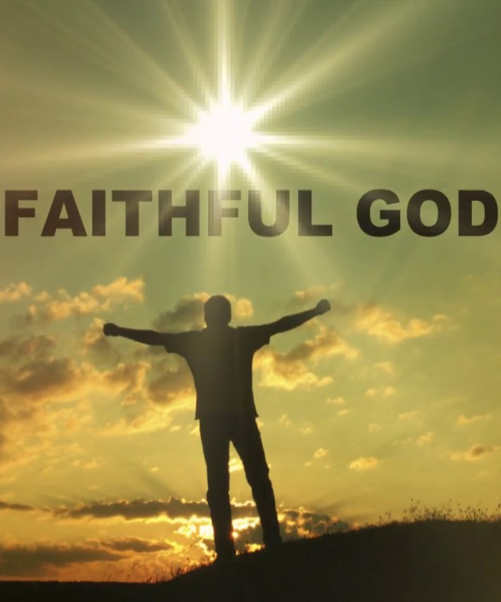
His faithfulness knows no bounds. It is to this attribute that we have been called to show forth in our daily lives.
This call to being faithful is not required of all but of those who have a covenant with the Living God.
It is the people of God who are called to be faithful. This becomes more relevant as darkness sweeps across the earth and truth is turned lie and every lie is virtually made the truth.
God expects us to remain faithful to shine His light amid darkness and His truth to prevail over the lies.

Slide 6

What Does It Mean To Be Faithful?

Slide 7
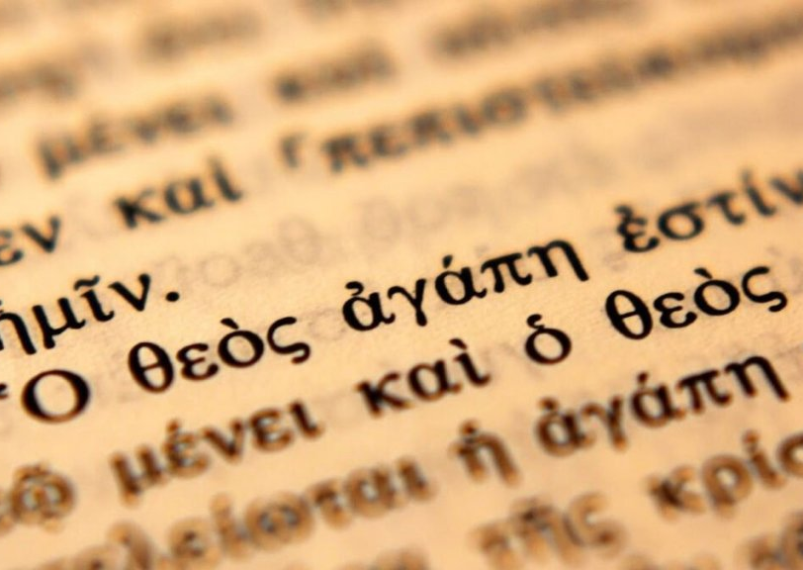
In the Greek New Testament, the word translated as faithful, pistosshares the same root with the word, faith, pistis.
Notes:
As the word itself appears, to be faithful is to be faith – full and that is to be full of faith

Slide 8
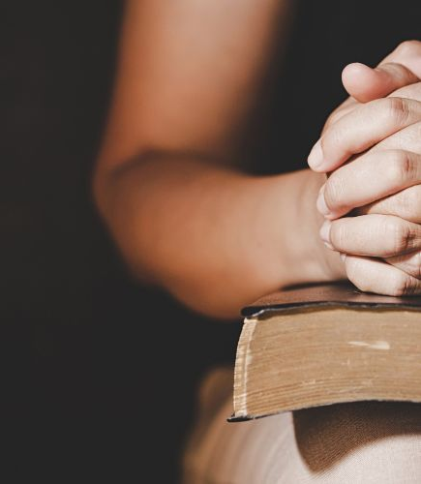
With this fullness of faith in a believer, then, he/she can exhibit the true meaning of the word, faithful.
It in God and what we believe that establishes our faithfulness. Being faithful, then, is remaining loyal and steadfast; and being true and truthful to the truth or what is the original, genuine and/or authentic.
It is a true-hearted commitment, dedication and devotion to what one believes and accepts.

Slide 9
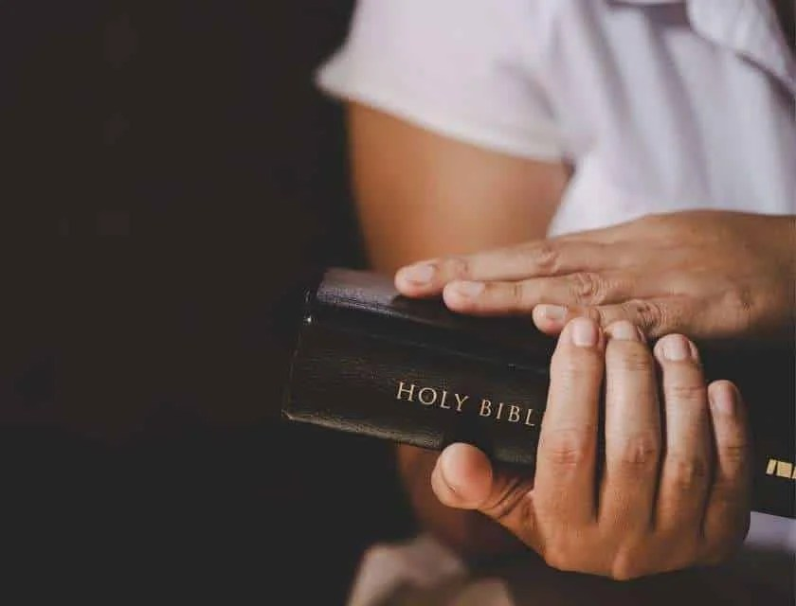
It is the giving of one’s pledge of allegiance and sanctified determination to live for God and His Word no matter the situation.
Being faithful shows one’s firmness of purpose like the Hebrews boys in Babylon (Daniel 1:1ff).
It represents the state of staying on course and not giving up even when the going gets tough. It is the staunchness and resoluteness to hold on to one’s integrity though the heavens fall.
Being faithful is, therefore, at the core of what it means to be a believer and a follower of Christ.

Slide 10

To Whom Are We To Be Faithful?

Slide 11
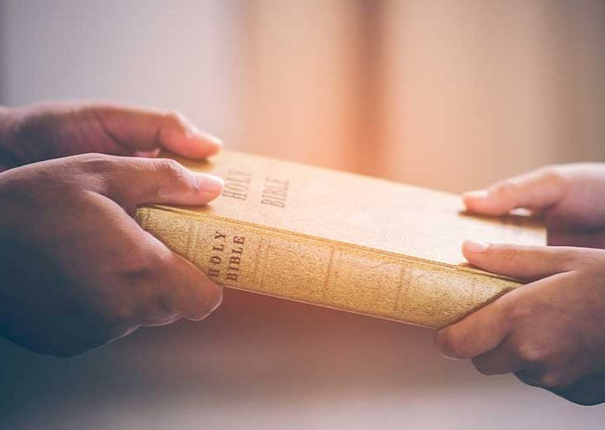
The call to be faithful is to God as the ultimate of our faith.
This faithfulness to God is expressed through the response to our calling and election to be part of God’s remnant, especially, in this end times.

Slide 12
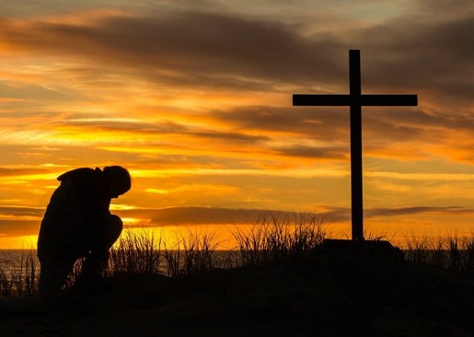
This is made possible by the expression of our faith in Jesus Christ as our Lord and personal Saviour in confession (Romans 10:9, 10) and follow Him our daily walk with Him (1Peter 2:21; Matthew 16:24; John 13:5; Philippians 2:5).

Slide 13
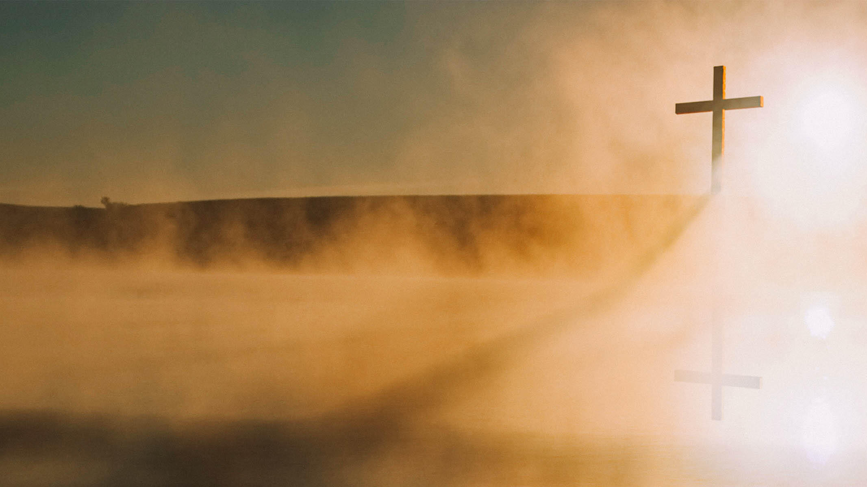
In this, we follow and reflect the example of Jesus Christ just as He remained faithful to the Father whilst on earth. Jesus whole life on earth was to be about His Father’s business (Luke 2:49). This is an act of faithfulness and what it means to be faithful.
Although, there were many distractions and attractions, He remained faithful to the Father and His work. We are also to be faithful in all things. We owe no other responsibility than to be what God wants us to be.

Slide 14
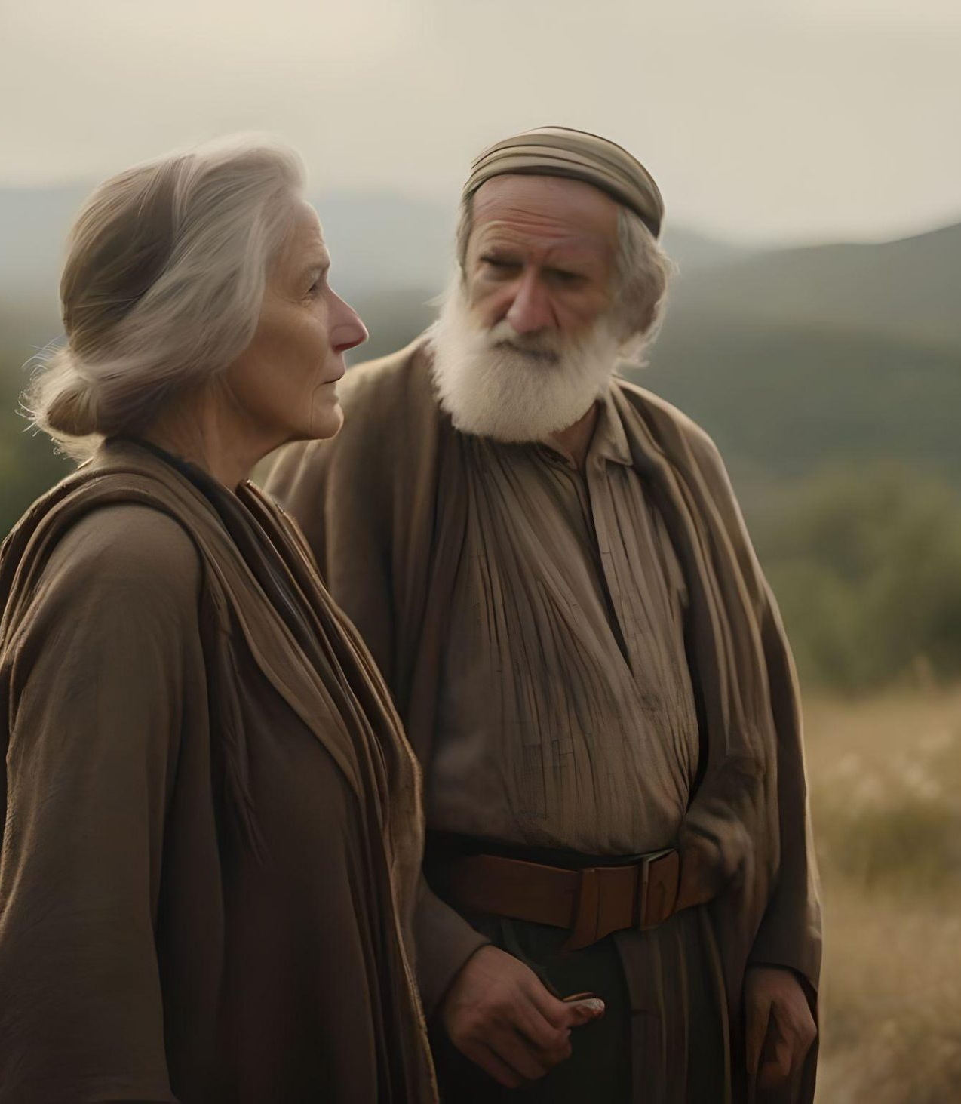
In Numbers 12:–3, when Aaron and Miriam spoke against their brother, Moses, the servant of God, God said to them as recorded in Numbers 12:4–9, that, Moses is faithful in all My House.” God Himself referred to Moses as faithful.

Slide 15
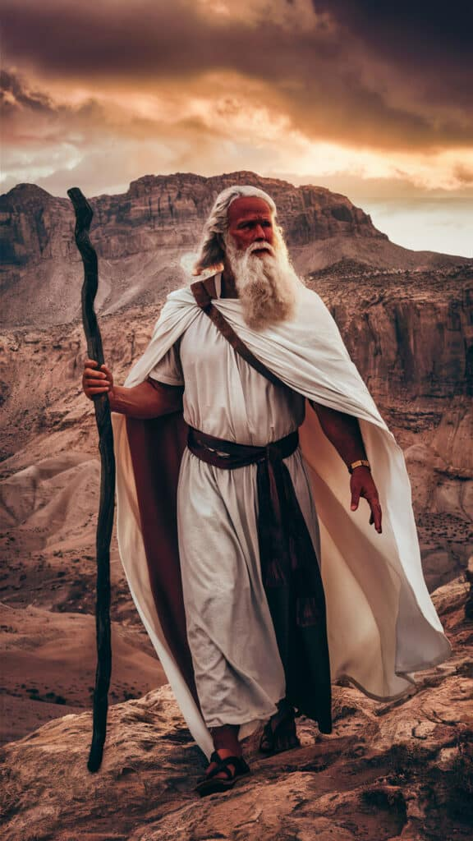
This does not mean that he had no flaws, weaknesses and some struggles in his personal life. Nonetheless, his true-heart devotion, unalloyed commitment and selfless dedication to God made God to called him faithful.

Slide 16
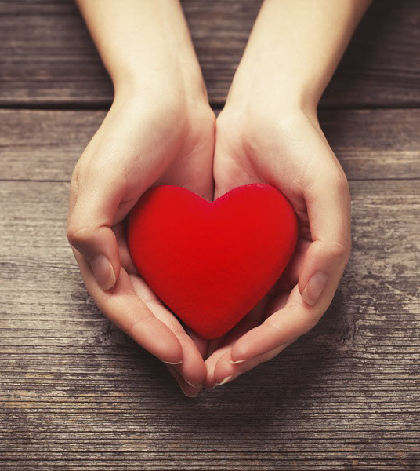
He gave his all to God and the ways of God were his ways. It is through this kind of selfless dedication, commitment and devotion to God that we are termed faithful.
Until we give our all to God in total surrender to Him, we cannot be referred to as faithful.
When we give our heart and surrender our all to Him faithfully, then, shall we give all our possessions to Him faithfully and nothing that we have would be hindered from Him.

Slide 17
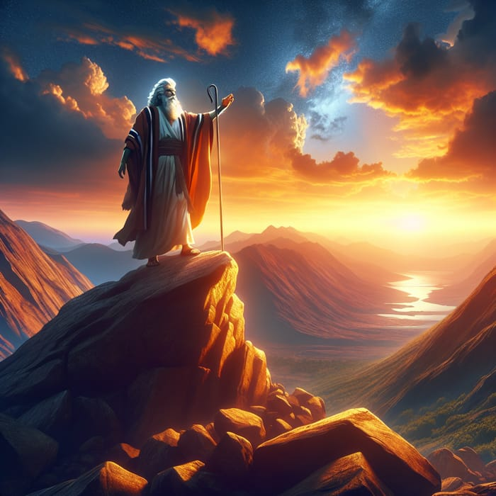
Moses did not see himself to able to accomplish what he was called to do but God was able to do it through him.
He leaned totally on God and used him as His instrument to accomplish His will.

Slide 18
Why must we be faithful?

Slide 19
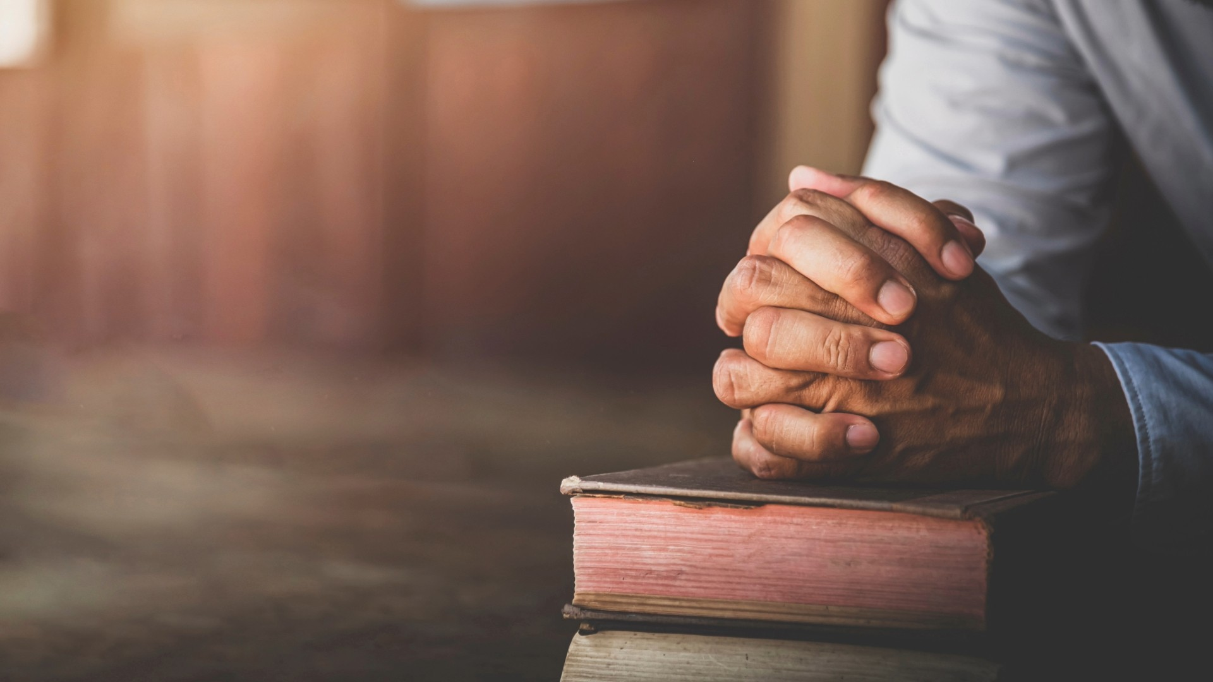
Being faithful is part of who we are as Christians. There is no option nor any negotiation for it. We are called to be faithful. It is, therefore, part of the fruit of the Holy Spirit (Galatians 5:22, 23).

Slide 20
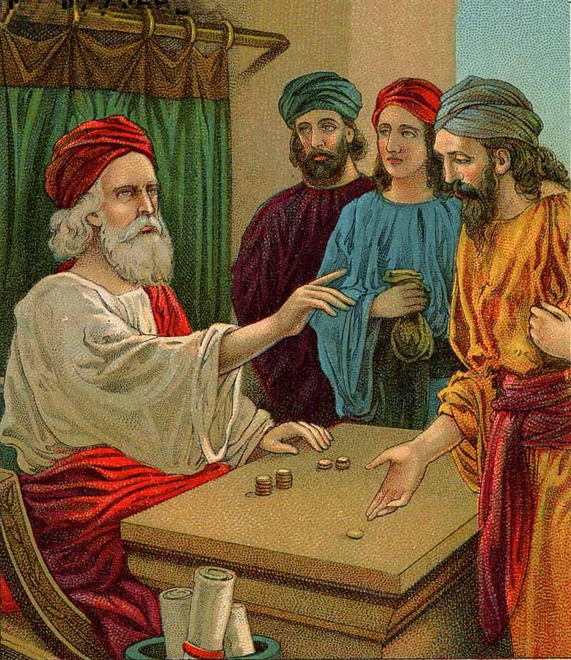
The two of the servants who did according to the Master’s desires, their Master said to them, “…Well done, good and faithful servant; you were faithful over a few things, I will make you ruler over many things. Enter into the joy of your lord.” (Matthew 25:21, 23).
Notes:
Jesus emphasized this virtue of being faithful in the parable of the talents as recorded in Matthew 25:14–30.

Slide 21
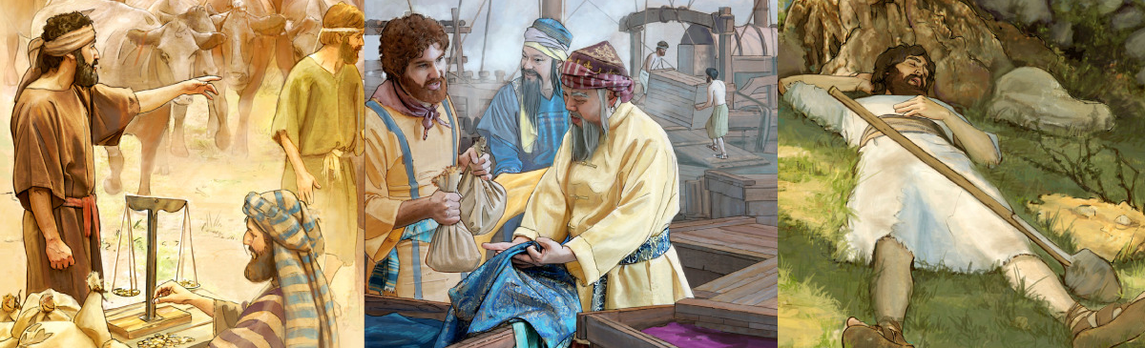
Although one received five talents and brought five talents more (100% turnover) and the other who received two also added two more (100% turnover), they both received the same acclamations as good and faithful servants. It is not the positions we have occupied whilst here that would mean anything in heaven but how faithful we are.

Slide 22

At the end of the day, it is only good and faithful servant that shall hear “Well done” for a work done well from the Lord.
No matter how high our positions or how low, one thing matters, our faithfulness.

Slide 23
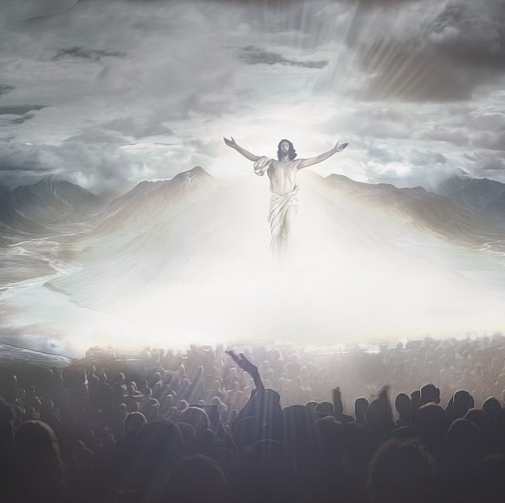
CONCLUSION
In this end times, the Lord counts on the faithful few to make His will known to the world.
The Psalmist in 12:1 wrote, “Help, LORD, for the godly man ceases! For the faithful disappear from among the sons of men.”

Slide 24
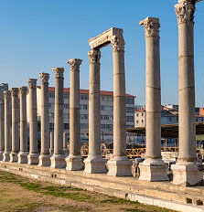
CONCLUSION
To the Church in Smyrna the Lord said, “Do not fear any of those things which you are about to suffer.
Indeed, the devil is about to throw some of you into prison, that you may be tested, and you will have tribulation ten days.

Slide 25
Be faithful until death, and I will give you the crown of life” (Revelation 2:10).
“Most men will proclaim each his own goodness, But who can find a faithful man?” (Proverbs 20:6).
God is looking through the earth to find those who are still standing faithful to Him and to His course.

Slide 26

Be faithful until death, and I will give you the crown of life” (Revelation 2:10).
“Most men will proclaim each his own goodness, But who can find a faithful man?” (Proverbs 20:6).
God is looking through the earth to find those who are still standing faithful to Him and to His course.

Slide 27

Will you be counted as faithful at the end of all things?

